Slide 2
Multiplying and Dividing Review
Mrs James
Year 11 Essentials

Slide 3

Learning Intentions
Students will be able to
Multiply and divide integers
WICOR

Slide 4
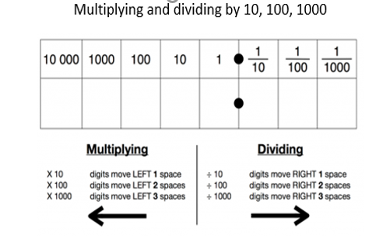
24
7
30
Multiplying and Dividing Review
Date:
EQ – What are the rules for multiplying and dividing?
Question
Multiplying decimals
Multiplying decimals is the same as multiplying two whole numbers. Just remember the following:
If there is one digit after the decimal point in the question, there will be one digit after the decimal point in the answer.
If there are two digits after the decimal point in the question, there will be two digits after the decimal point in the answer etc.

Slide 5
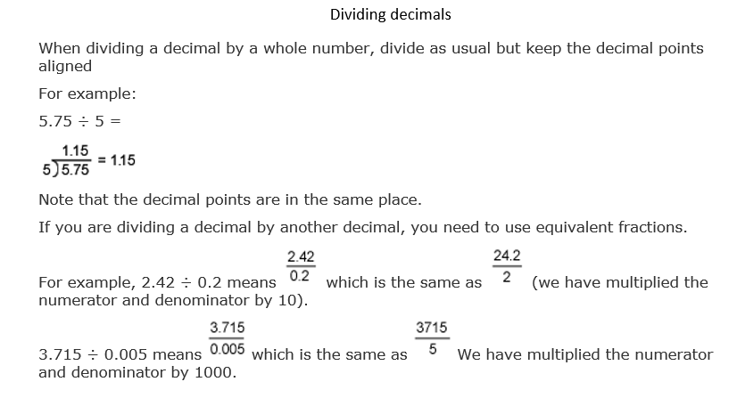
24
7
30
Multiplying and Dividing Review
Date:
EQ – What are the rules for multiplying and dividing?
Question

Slide 6


Slide 7
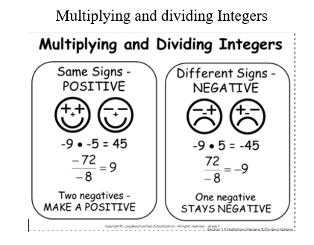
24
7
30
Multiplying and Dividing Review
Date:
EQ – What are the rules for multiplying and dividing?
Question

Slide 8
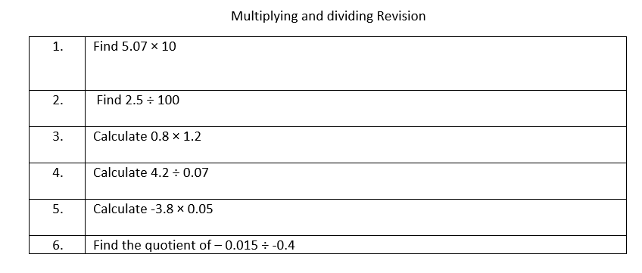
Practice

